Slide 1
HNDIT1212: System Analysis and Design
Problem Identification Methods

Slide 2
Problem Definition
Identifying Requirements
Most important factors in building correct systems is to first clearly define what the system must do
Requirements may be functional or non-functional

Slide 3
Requirements elicitation
Requirements elicitation is the process of identifying the sources of requirements for a new system and obtaining those requirements from those sources.

Slide 4
System Requirements
Specify what the information system must do, or what property / quality the system must have
System Requirements
Functional Requirements
Non functional Requirements
Specify what the information system must do
Specify a property / quality the system must have
Example : Library system
Functional- borrowing books, returning process
Non functional- security level, interfaces

Slide 5

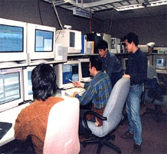



Fact Finding techniques
Research and site visits
Sampling of Existing documents
Observations of the work environment
Questionnaires
Joint requirements planning
Interviews
Prototyping

Slide 6
Requirement Discovery Methods (Fact Finding Techniques)
It is the formal process of using techniques to collect information about systems requirements
Methods
Sampling of existing documents
Research and site visits
Observations of the work environment
Questionnaires
Interviews
Joint requirements planning
Brainstorming

Slide 7

1. Sampling of existing documents
You can get good idea by studying existing
Documents
Forms
files

Slide 8
Documents
Documents that describe the problem
Inter office memo
Mints of meeting
Customer complain
Accounting records
Document that describe business functions
Company mission statements
Objective of the organization
Documents that describe previous studies
Feasibility report

Slide 9
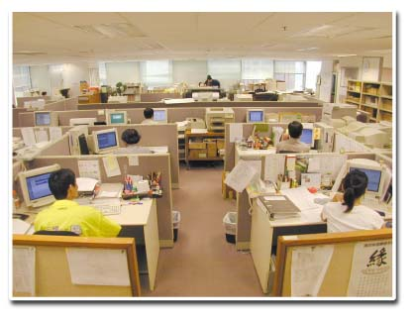




2. Research and site visits
Thoroughly, research the problem domain.
Identify the material that are relevant and reliable
Internet
Intranets
Computer trade
Journals
Reference books
Good sources of information
World Wide Web

Slide 10

3. Observations of the work environment
System Analyst participates in or watches a person perform activities to learn about the system.
Advantages
Highly reliable.
Relatively inexpensive
Disadvantages
People usually feel uncomfortable when being watched

Slide 11
4. Questionnaires
Questionnaires are special purpose documents that allow the analysts to collect information and opinions from a large audience.
Advantages
Most questionnaires Can be answered quickly.
Allow individuals to maintain anonymity.
Relatively inexpensive way of gathering data.
Responses can be tabulated and analyzed quickly etc.

Slide 12
Questionnaires….
Disadvantages
Number of responses is often low.
No guarantee that an individual will answer or expand on all the questions
Difficult to prepare

Slide 13
Type of questionnaires
Free-format:
A question is asked, and the respondent records the answer in the space provided after the question.
Eg:
What additional reports would you require from the system?
…………………………………………………………………………………………………………………………………………………………
Fixed-format:
Contains questions that required specific responses from individuals.

Slide 14
Three type of fixed-format questions
1)Yes /No Questions E.g: Do you print reports from the existing system? Yes No
2) Multiple choice questions
E.g.: How many new clients do you obtain in a year? (Please tick one box only)
a) 1-10 11-20 21-30 31+
3) Rating questions
E.g: How satisfied are you with the response time of the stock update?
1) Very Satisfied 2) Satisfied 3) Dissatisfied 4) Very dissatisfied

Slide 15
5. Interviews
System Analyst collects information from individuals face to face.
Advantages
Gives the analyst an opportunity to motivate the interviewee to respond freely and openly to questions.
Allow the analyst to look for more feedback from the interviewee.
Permit the analyst to ask questions from each individuals.
New ideas may arise

Slide 16
5. Interviews….
Disadvantages
Very time consuming. Therefore costly approach.
Depend on analyst ‘s human relations skill.
Types of Interviews
Unstructured interviews
Structured interviews
Types of interview questions
Open ended
Closed ended

Slide 17
How to conduct an interview?
Select interviewees
Prepare an interview guide
Use clear and concise language.
Don’t include your opinion as part of a question.
Avoid long and complex question
Avoid threatening questions
verify before you leave
Notes:
Concise=summary

Slide 18
6.Joint requirements planning
Highly structured group meeting are conducted to analyze problems and define requirements.
JRP is a subset of a more comprehensive joint application development or JAD technique.

Slide 19

7. Brainstorming
Brainstorming sessions are used to let the stakeholders come up with creative ideas or new approaches to a problem

